Slide 1


Department of Computer Science And Engineering
JAWAHARLAL NEHRU TECHNOLOGICAL UNIVERSITY HYDERABAD
UNIVERSITY COLLEGE OF ENGINNERING HYDERABAD
(Established by State Act No. 30 of 2008)
Kukatpally, Hyderabad, Telangana (India)- 500 085.
Dissertation Work Review - I
Date: 27-08-2026 From 10:00 am to 5:00 pm
Title of the Dissertation work:
NyaayPredict: Predicting Supreme Court Judgment Outcomes using Machine Learning
Presented By :
Under the Supervision of :
Name: Kavali Yedidyah Sagar
Dr. G. Vijaya Kumari
Roll No: 22011P0535
Professor of CSE Department
Class : IDP (B.Tech + M.Tech)
JNTUH, Kukatpally, Hyderabad
Year and Semester: V Year I Semester
Batch: 2022-2027

Slide 2
CONTENT | SLIDE NUMBER
ABSTRACT | 1
INTRODUCTION | 2
EXISTING WORK | 6
PROPOSED WORK | 8
DATASET | 13
METHODOLOGY | 15
ARCHITECTURE | 16
CONCLUSION | 24
REFERENCES | 25

Slide 3
ABSTRACT
The Indian judiciary handles a large number of cases every year at the Supreme Court. Each of these is a request for the Court to review a matter and decide in favor of one party, with a binary outcome: Accepted (the petitioner/appellant wins) or Rejected (the original decision stands, or the claim is dismissed). Prior work on judgment prediction relies mostly on the judge's reasoning near the end of the document, rather than the actual facts and arguments. The dataset also treats all Supreme Court cases as one pool, even though case types like SLPs go through two separate decisions (whether the Court agrees to hear the case, and then whether it accepts or rejects it), which may be getting mixed into a single misleading label. This raises two research questions: 1) Can a model trained only on the facts and arguments, without relying on the judge's reasoning, still give good predictions. 2) Can classifying the cases by type first, and training separate models for each type, improve prediction accuracy.
This project uses machine learning to predict case outcomes, given the facts and arguments of a case, without the final verdict. We propose using InLegalBERT, a transformer pretrained specifically on Indian legal text, to better capture domain-specific legal language. We will use the ILDC dataset (34,816 Supreme Court case documents, each labeled accepted or rejected), evaluated using Accuracy, Precision, Recall, F1-score, and a Confusion Matrix.
It is expected that this study will identify whether a meaningful legal signal exists earlier in a case document, independent of the judge’s reasoning, and whether classifying cases by type improves prediction accuracy or reasoning quality.
1

Slide 4
PROBLEM STATEMENT :
The objective of this project is to develop a machine learning model, using InLegalBERT, that predicts Supreme Court judgment outcomes from the facts and arguments of a case alone, independent of the judge's final reasoning.
2

Slide 5
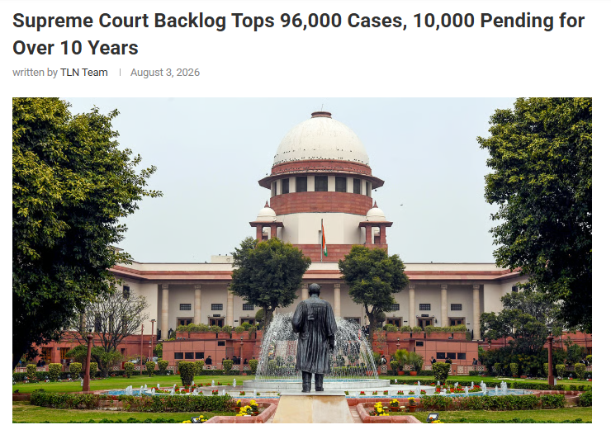
BACKGROUND OF THE PROBLEM :
Ref : https://thelivenagpur.com/2026/08/03/supreme-court-backlog-tops-96000-cases-10000-pending-for-over-10-years/
3

Slide 6
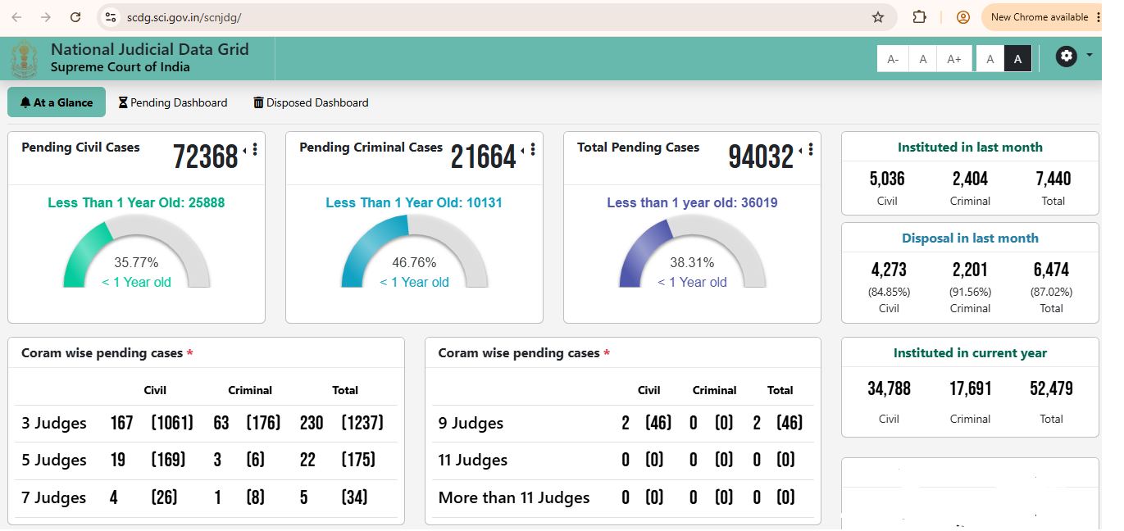
TOTAL BACKLOG CASES IN SUPREME COURT
4

Slide 7
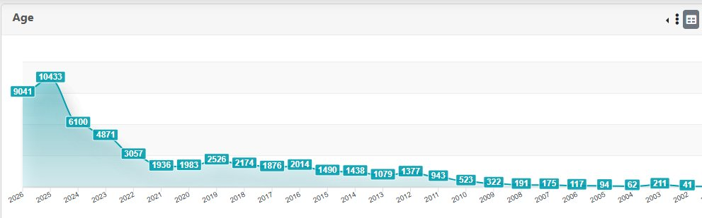
INCREASING NUMBER OF PENDING CASES IN THE SUPREME COURT
5

Slide 8
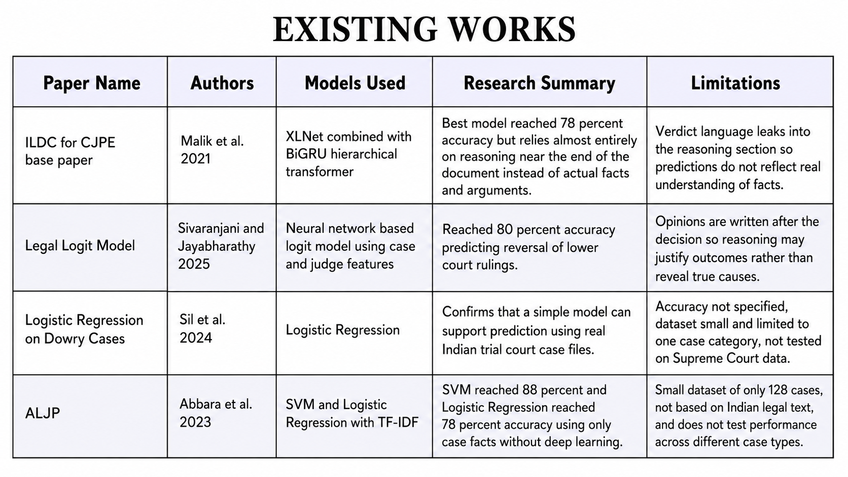
6

Slide 9
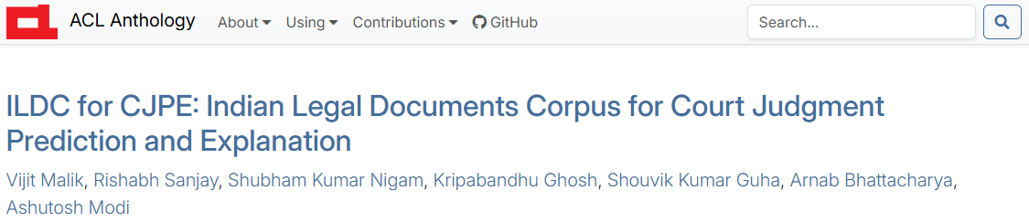
EXISTING WORK : (BASE PAPER)
Authors/Year: Malik et al. (2021)
What they did: Introduced CJPE task - Binary judgment prediction on Indian Supreme Court cases using transformer models
Dataset used: ILDC (34,816 case documents)
Key finding: Models perform well by relying on reasoning near the end of the document
Limitations:
Doesn't distinguish case types (SLPs, Writs, Appeals)
Doesn't test whether facts/arguments alone are sufficient
7

Slide 10
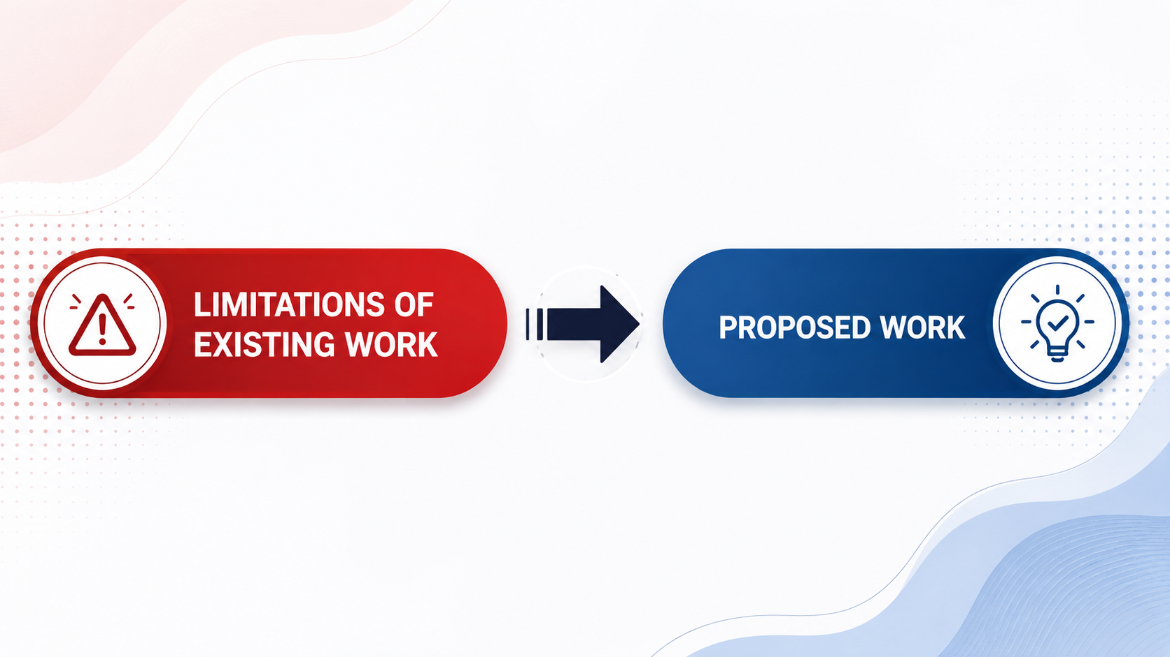
8

Slide 11
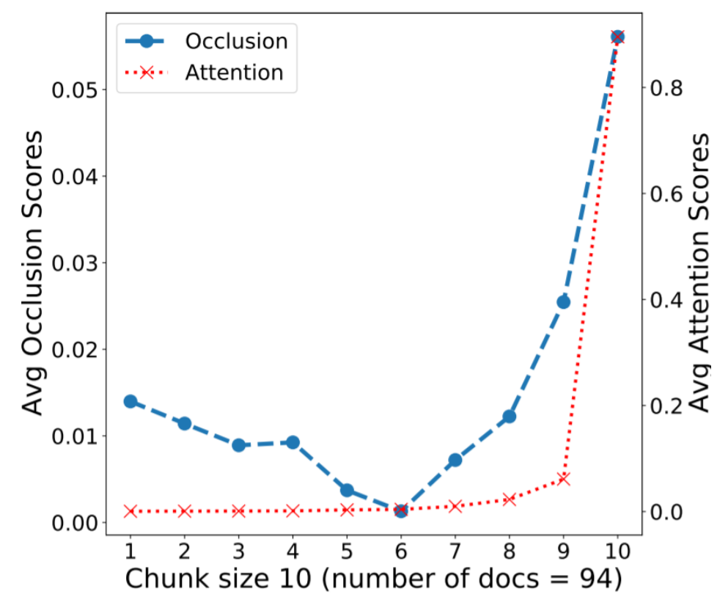
ATTENSION & OCCLUSION SCORES vs Chunks
Attention: A mechanism learned by the model during training that enables it to focus more on important words or sentences, rather than treating the entire document equally.
Occlusion: A technique applied during testing that involves removing parts of the input to observe the resulting change in prediction, thereby identifying which parts were most influential.
9

Slide 12
Limitation 1 :
CJPE models rely mainly on the final 512 tokens
Attention & occlusion scores peak there
Verdict sentences are removed, but judge's reasoning is still present
Models predict outcomes without processing earlier facts, arguments, precedents
Research Question 1 :
Can a model trained only on the earlier facts and arguments (without the reasoning near the end) still make accurate predictions?
10

Slide 13
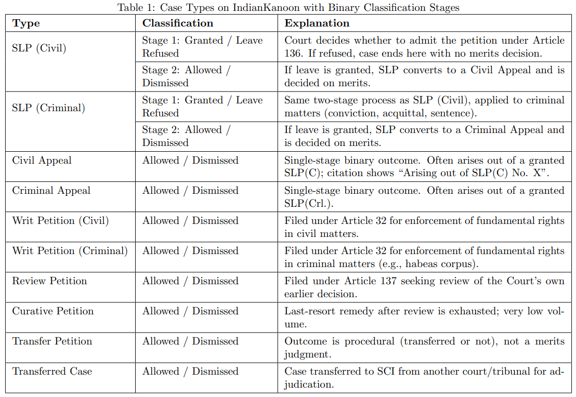
SLP (Special Leave Permission) :
It is a special way to ask the Supreme Court of India for permission to hear an appeal.
It challenges a judgment or order from any lower court or high court in the country.
It is not a basic right. The top court decides if it wants to hear the case
11

Slide 14
Limitation 2 :
ILDC/CJPE treat all Supreme Court cases as a single uniform group for binary prediction
Ignores structurally & legally distinct case types (Civil/Criminal Appeals, SLP Civil/Criminal, Writ Petitions, etc)
SLPs go through two decisions: (1) whether to admit the case, (2) whether to accept/reject on merits
Dataset merges both into a single "accepted"/"rejected" label
A refusal to hear ≠ a rejection after full hearing : Merging them creates misleading labels
Research Question 2 :
Does separating cases by type and splitting "refused to hear" from "heard and rejected", actually improve model performance?
12

Slide 15
DATASET
Parameter | Details
Name of the dataset | ILDC (Indian Legal Documents Corpus)
Downloaded from | https://huggingface.co/datasets/Exploration-Lab/IL-TUR
Size of datasets | 814 MB
Number of Attributes | 4
Attributes used | Id, District, Text, Label
13

Slide 16
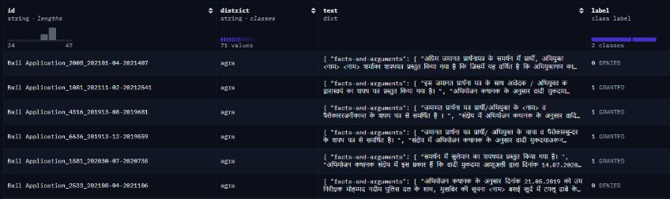
DATASET
First 5 rows of the dataset :
14

Slide 17
METHODOLOGY :
4 Main Stages :
Data Preparation
Feature Engineering
Modeling and Evaluation
Analysis and Findings
15

Slide 18
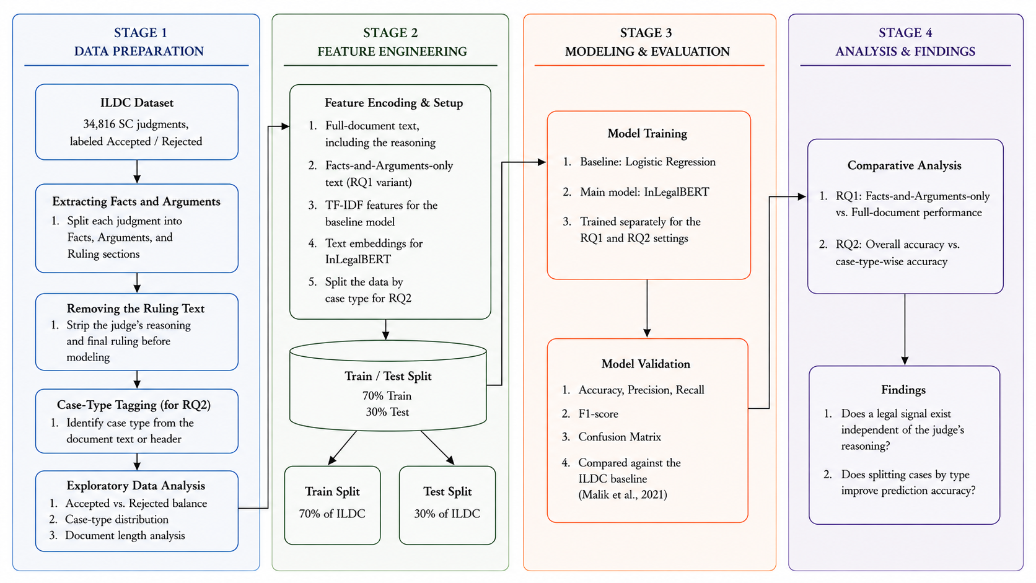
PROPOSED ARCHITECTURE FOR NYAAYPREDICT
16

Slide 19
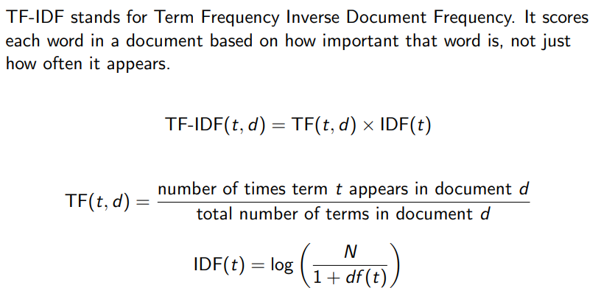
FEATURE ENGINEERING :
1) TF-IDF for Base Model :
17

Slide 20
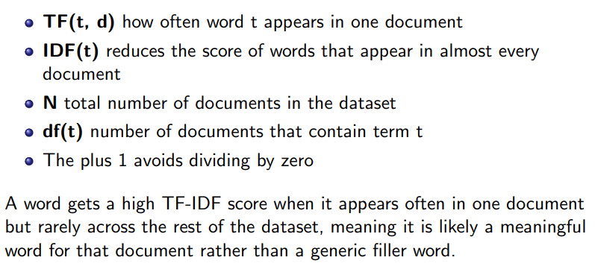
FEATURE ENGINEERING :
1) TF-IDF for Base Model :
18

Slide 21
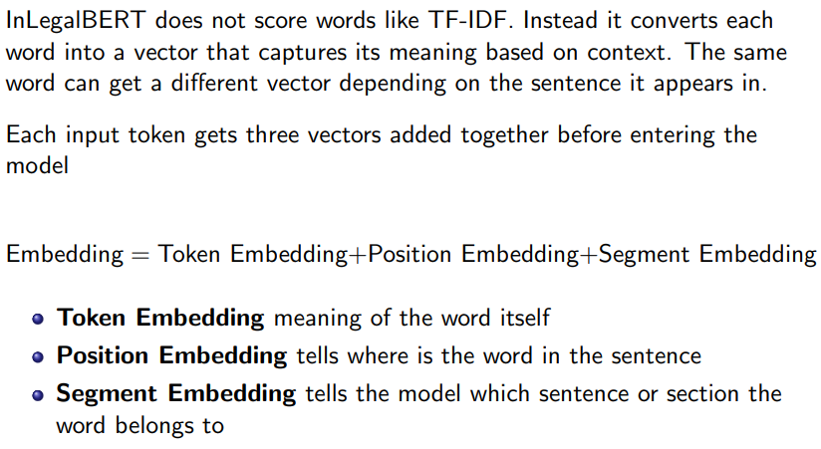
FEATURE ENGINEERING :
2) Embedding for InLegalBERT :
19

Slide 22
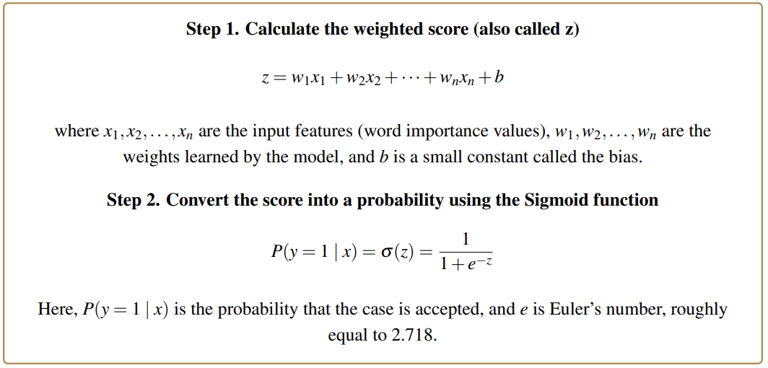
MODEL BUILDING :
1) Logistic Regression (BASE MODEL) :
20

Slide 23
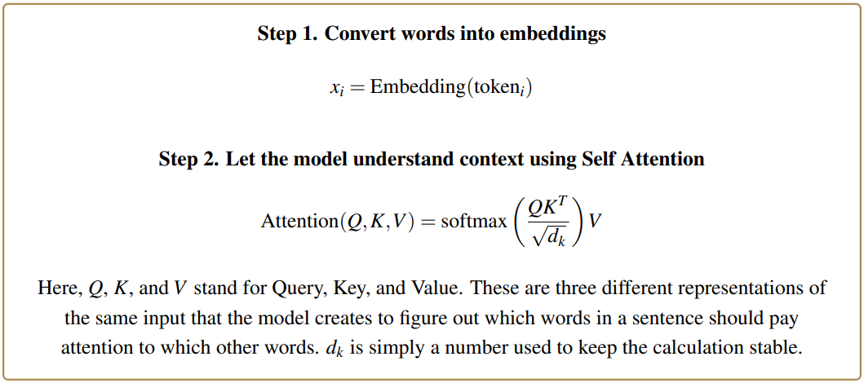
MODEL BUILDING :
2) InLegalBERT :
21

Slide 24
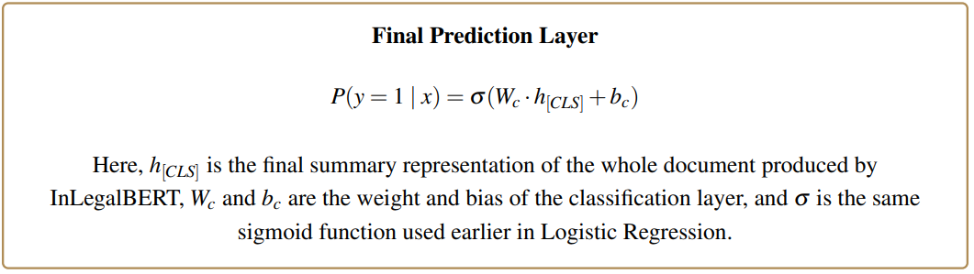
MODEL BUILDING :
2) InLegalBERT :
22

Slide 25
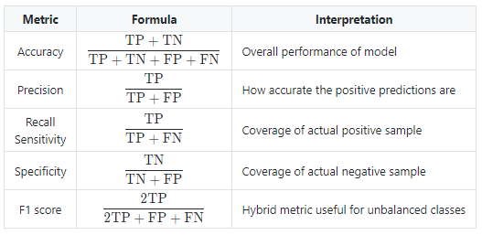
,
MODEL EVALUATION
23

Slide 26
CONCLUSION :
Problem: Existing models predict SC judgments off the judge's reasoning, not the actual facts/arguments and also pools all case types together
What to do: This project predicts outcomes using only facts & arguments, and tests whether splitting cases by type improves accuracy.
How to do it: Train InLegalBERT on the ILDC dataset (34,816 cases). Remove reasoning, engineer features, train & evaluate (Accuracy, Precision, Recall, F1) against a Logistic Regression baseline model.
24

Slide 27
REFERENCES :
1. Malik, V., Sanjay, R., Nigam, S. K., Ghosh, K., Guha, S. K., Bhattacharya, A., & Modi, A. (2021). ILDC for CJPE: Indian Legal Documents Corpus for Court Judgment Prediction and Explanation. ACL-IJCNLP 2021, 4046–4062.
2. Paul, S., Mandal, A., Goyal, P., & Ghosh, S. (2022). Pre-trained language models for the legal domain: A case study on Indian law. arXiv:2209.06049.
3. Sivaranjani, S., & Jayabharathy, J. (2025). Legal logit model for predicting reversal of lower court rulings using case and judge features.
4. Sil, R., et al. (2024). Logistic regression-based prediction of dowry case outcomes using Indian trial court records.
5. Abbara, F., et al. (2023). ALJP: Automated legal judgment prediction using SVM and logistic regression with TF-IDF features.
6. The Live Nagpur. (2026, August 3). Supreme Court backlog tops 96,000 cases; 10,000 pending for over 10 years. https://thelivenagpur.com/2026/08/03/supreme-court-backlog-tops-96000-cases-10000-pending-for-over-10-years/
25

